Slide 1
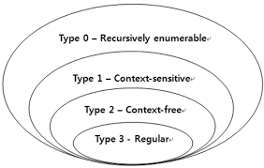

Slide 2
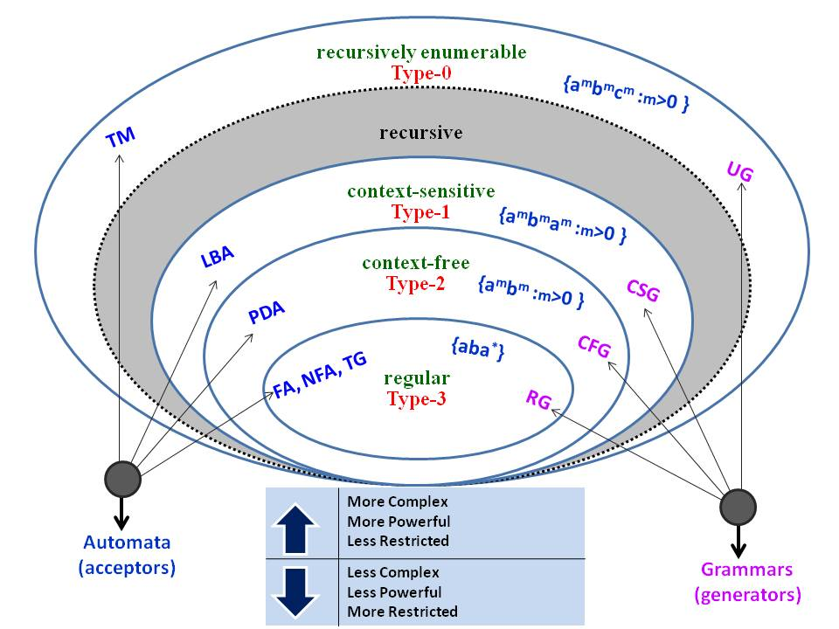

Slide 3
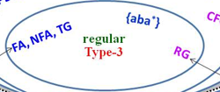

Slide 4
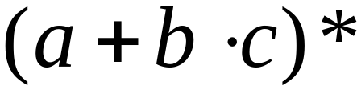
Regular Expressions
Regular expressions describe regular languages
Example:
describes the language
Courtesy Costas Busch - RPI

Slide 5



Regular Expressions
Given regular expressions and
Are regular expressions
Courtesy Costas Busch - RPI

Slide 6
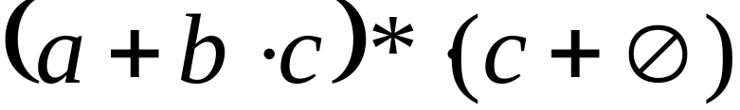
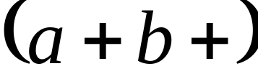
Examples
A regular expression:
Not a regular expression:
Courtesy Costas Busch - RPI

Slide 7
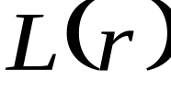

Languages of Regular Expressions
: language of regular expression
Example
Courtesy Costas Busch - RPI

Slide 8
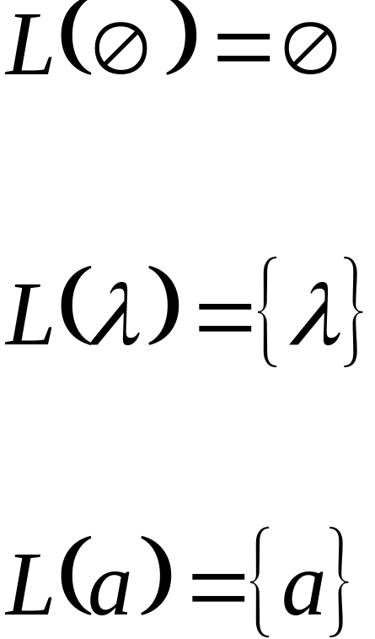
Definition
For primitive regular expressions:
Courtesy Costas Busch - RPI

Slide 9




Definition (continued)
For regular expressions and
Courtesy Costas Busch - RPI

Slide 10

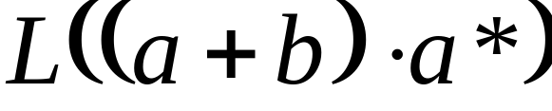




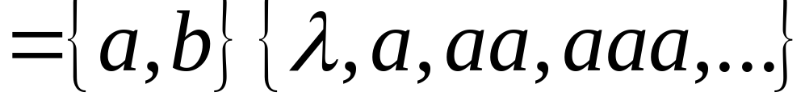
Example
Regular expression:
Courtesy Costas Busch - RPI

Slide 11

Example
Regular expression
Courtesy Costas Busch - RPI

Slide 12




Example
Regular expression
If n, m >= 1
Courtesy Costas Busch - RPI

Slide 13


Example
Regular expression
= { all strings with at least two consecutive 0 }
Courtesy Costas Busch - RPI

Slide 14
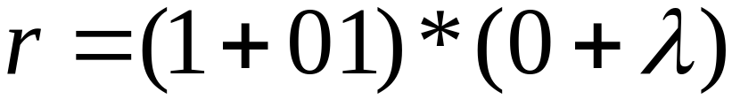
Example
Regular expression
= { all strings without two consecutive 0 }
Courtesy Costas Busch - RPI

Slide 15

Equivalent Regular Expressions
Definition:
Regular expressions and
are equivalent if
Courtesy Costas Busch - RPI

Slide 16

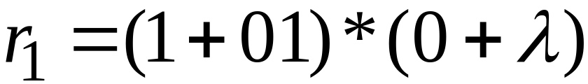

Example
= { all strings without two consecutive 0 }
and
are equivalent
regular expr.
Courtesy Costas Busch - RPI

Slide 17
Task
Q)
Let S={ab, bb} and T={ab, bb, bbbb} Show
that S* = T* [Hint S* ⊆ T* and T* ⊆ S*]
2) Let S={ab, bb} and T={ab, bb, bbb} Show that S* ≠ T* But S* ⊂ T*

Slide 18
3) Let S={a, bb, bab, abaab} be a set of strings. Are abbabaabab and baabbbabbaabb in S*? Does any word in S* have odd number of b’s?
Solution: since abbabaabab can be grouped as (a)(bb)(abaab)ab , which shows that the last member of the group does not belong to S, so abbabaabab is not in S*, while baabbbabbaabb can not be grouped as members of S, hence baabbbabbaabb is not in S*. Since each string in S has even number of b’s so there is no possiblity of any string with odd number of b’s to be in S*.

Slide 19
Task
Q1)Is there any case when S⁺ contains Λ? If yes then justify your answer.

Slide 20
Q2) Prove that for any set of strings S
(S⁺)*=(S*)*
Solution: In general Λ is not in S⁺ , while Λ does belong to S*. Obviously Λ will now be in (S⁺)*, while (S*)* and S* generate the same set of strings. Hence (S⁺)*=(S*)*.

Slide 21
Q2) continued…
ii) (S⁺)⁺=S⁺
Solution: since S⁺ generates all possible strings that can be obtained by concatenating the strings of S, so (S⁺)⁺ generates all possible strings that can be obtained by concatenating the strings of S⁺ , will not generate any new string.
Hence (S⁺)⁺=S⁺

Slide 22
Q2) continued…
Is (S*)⁺=(S⁺)*
Solution: since Λ belongs to S* ,so Λ will belong to (S*)⁺ as member of S* .Moreover Λ may not belong to S⁺, in general, while Λ will automatically belong to (S⁺)*.
Hence (S*)⁺=(S⁺)*

Slide 23
Regular Expression
As discussed earlier that a* generates
Λ, a, aa, aaa, …
and a⁺ generates a, aa, aaa, aaaa, …, so the language L₁ = {Λ, a, aa, aaa, …} and L₂ = {a, aa, aaa, aaaa, …} can simply be expressed by a* and a⁺, respectively.
a* and a⁺ are called the regular expressions (RE) for L₁ and L₂ respectively.
Note: a⁺, aa* and a*a generate L₂.

Slide 24
Defining Languages (continued)…
Method 3 (Regular Expressions)
  Consider the language L={Λ, x, xx, xxx,…} of strings, defined over Σ = {x}.
  We can write this language as the Kleene star closure of alphabet Σ or L=Σ*={x}*
  this language can also be expressed by the regular expression x*.
  Similarly the language L={x, xx, xxx,…}, defined over Σ = {x}, can be expressed by the regular expression x⁺.

Slide 25
  Now consider another language L, consisting of all possible strings, defined over Σ = {a, b}. This language can also be expressed by the regular expression
  .
  Now consider another language L, of strings having exactly double a, defined over Σ = {a, b}, then it’s regular expression may be
(a + b)*
b*aab*

Slide 26
  Now consider another language L, of even length, defined over Σ = {a, b}, then it’s regular expression may be
  Now consider another language L, of odd length, defined over Σ = {a, b}, then it’s regular expression may be
((a+b)(a+b))*
(a+b)((a+b)(a+b))* or
((a+b)(a+b))*(a+b)

Slide 27
Remark
It may be noted that a language may be expressed by more than one regular expressions, while given a regular expression there exist a unique language generated by that regular expression.

Slide 28
Example:
  Consider the language, defined over
  Σ={a , b} of words having at least one a, may be expressed by a regular expression
  .
  Consider the language, defined over
  Σ = {a, b} of words having at least one a and one b, may be expressed by a regular expression.
  .
(a+b)*a(a+b)*
(a+b)*a(a+b)*b(a+b)*+ (a+b)*b(a+b)*a(a+b)*

Slide 29
  Consider the language, defined over
  Σ={a, b}, of words starting with double a and ending in double b then its regular expression may be
  Consider the language, defined over
  Σ={a, b} of words starting with a and ending in b OR starting with b and ending in a, then its regular expression may be
aa(a+b)*bb
a(a+b)*b+b(a+b)*a

Slide 30
TASK
  Consider the language, defined over
  Σ={a, b} of words beginning with a, then its regular expression may be
  Consider the language, defined over
  Σ={a, b} of words beginning and ending in same letter, then its regular expression may be
a(a+b)*
(a+b)+a(a+b)*a+b(a+b)*b

Slide 31
TASK
  Consider the language, defined over
  Σ={a, b} of words ending in b, then its regular expression may be.
  Consider the language, defined over
  Σ={a, b} of words not ending in a, then its regular expression may be . It is to be noted that this language may also be expressed by.
(a+b)*b
(a+b)*b + Λ
((a+b)*b)*

Slide 32

Strings not containing 110.

Slide 33
The set of all strings with an even number of 0’s
1*+ (1*01*0)*1*

Slide 34

The set of string starting with 110.

Slide 35

Set of string containing exactly three 1’s.

Slide 36
The set of string where third last symbol is 1.

Slide 37
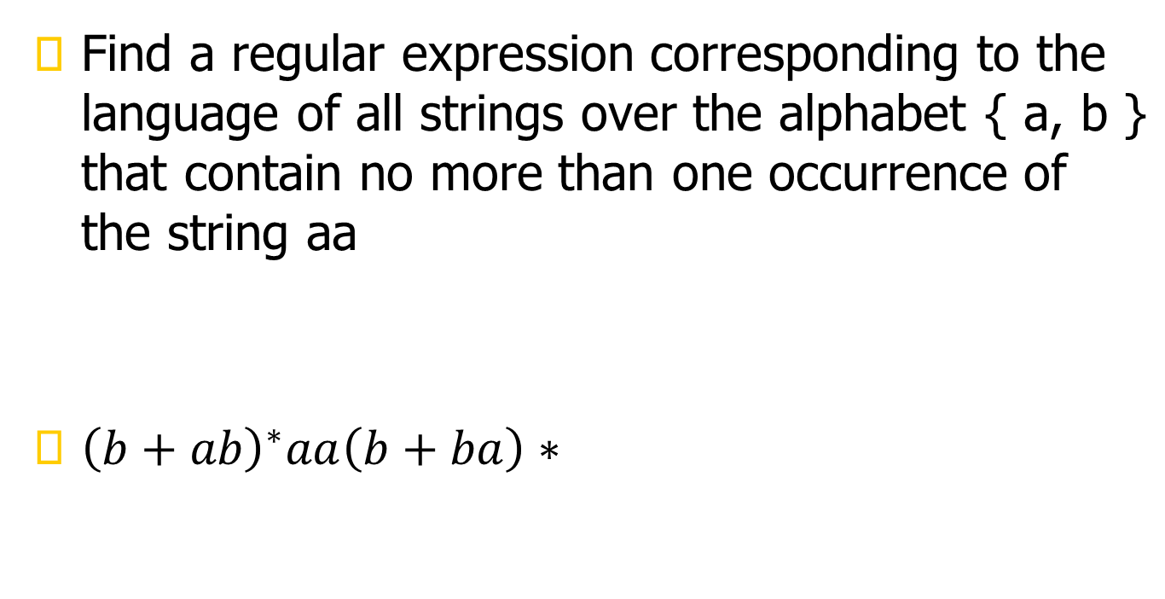

Slide 38
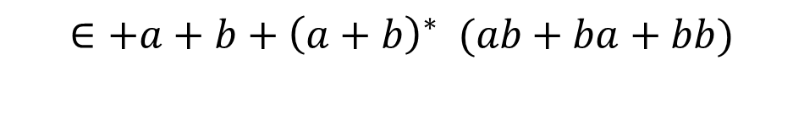
Language of the strings that do not end with aa.

Slide 39
All the strings that contain an even number of b’s.

Slide 40

Describe as simply as possible in English the language corresponding to the regular expression
The language of string having odd number of bs

Slide 41
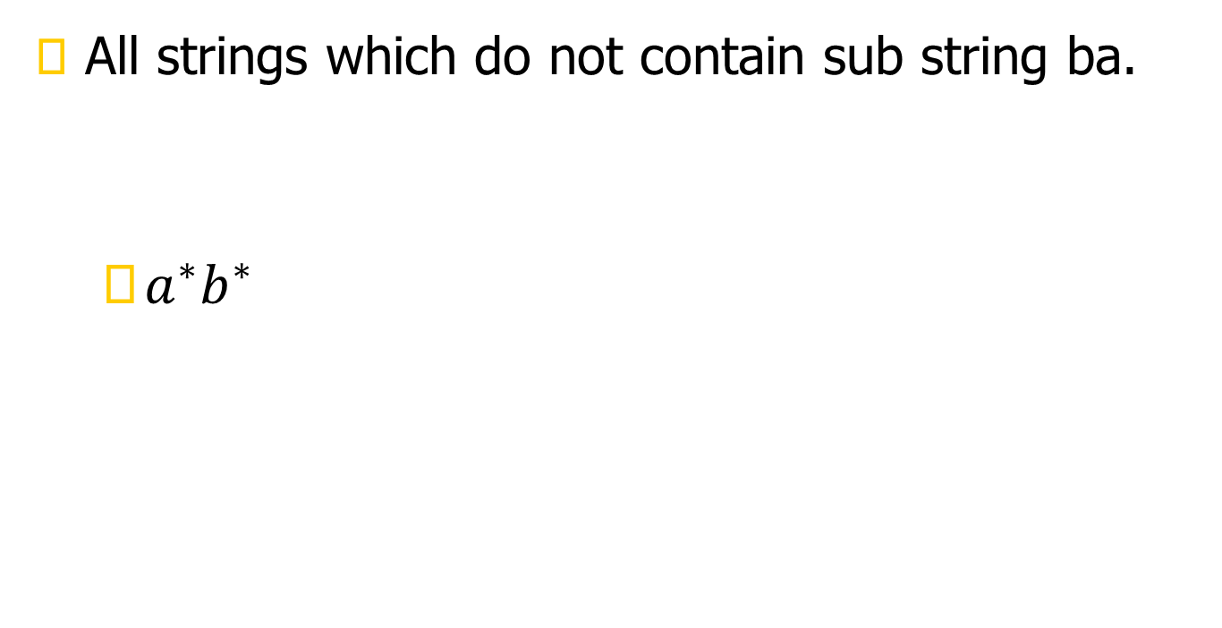

Slide 42

Regular expression for even even language

Slide 43
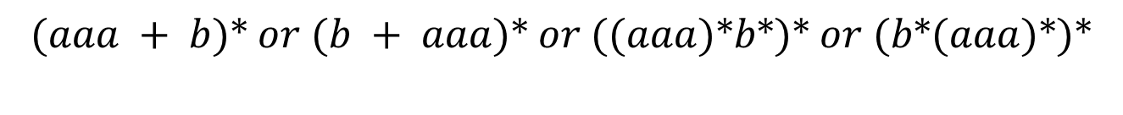
Construct a regular expression for all words in which a appears tripled, if at all. This means
that every clump of a’s contains 3 or 6 or 9 or 12… a’s.

Slide 44

4. Construct a regular expression for all words that contain exactly two b’s or exactly three b’s,
not more

Slide 45
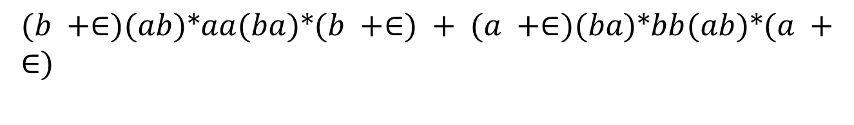
. Construct a regular expression for all strings that have exactly one double letter in them.

Slide 46
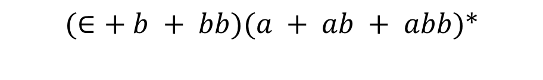
Construct a regular expression for all strings in which the letter b is never tripled. This means that no word contains the substring bbb.

Slide 47

Construct a regular expression for all strings in which the total number of a’s is divisible by
3 no matter how they are distributed, such as aabaabbaba

Slide 48
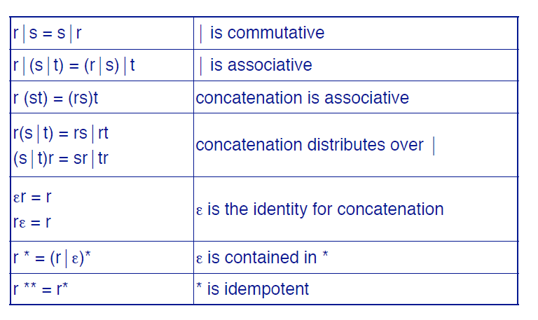
Algebraic Properties

Slide 49
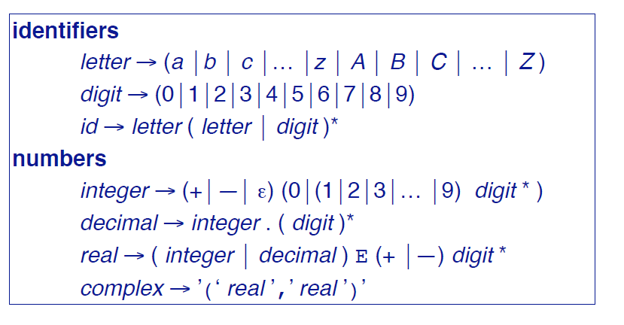
Using R.E for Tokenization

Slide 50
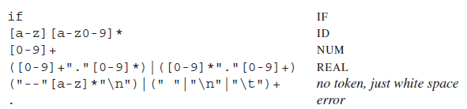
R.E. and Tokens – Our job
Assign a token type to a subset of input stream, based on its matching with a RE
The fifth line recognizes comments or white space but does not report back to the parser.
White space is discarded and the lexer resumed.
The comments for this lexer begin with two dashes, contain only alphabetic characters, and end with newline.

Slide 51
SummingUP Lecture 2
RE, Recursive definition of RE, defining languages by RE, { x}*, { x}⁺, {a+b}*, Language of strings having exactly one aa, Language of strings of even length, Language of strings of odd length, RE defines unique language (as Remark), Language of strings having at least one a, Language of strings havgin at least one a and one b, Language of strings starting with aa and ending in bb, Language of strings starting with and ending in different letters.

